Slide 1
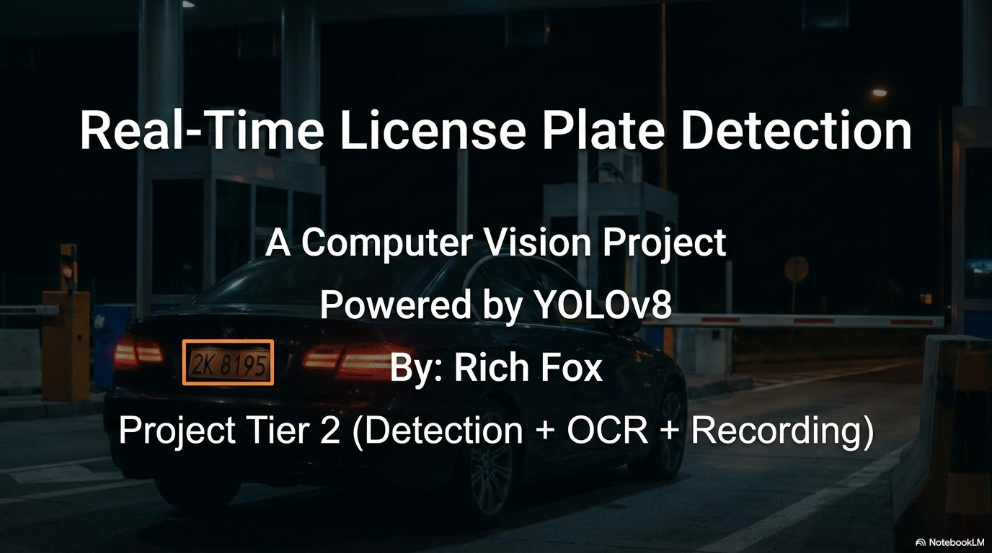
Notes:
Hi, I'm Rich Fox, and this is my Tier 2 computer vision project: Real-Time License Plate Detection. The system uses YOLOv8 for object detection paired with EasyOCR to read plates from live video feeds. I'll walk you through the problem, the architecture, and how it performed.

Slide 2
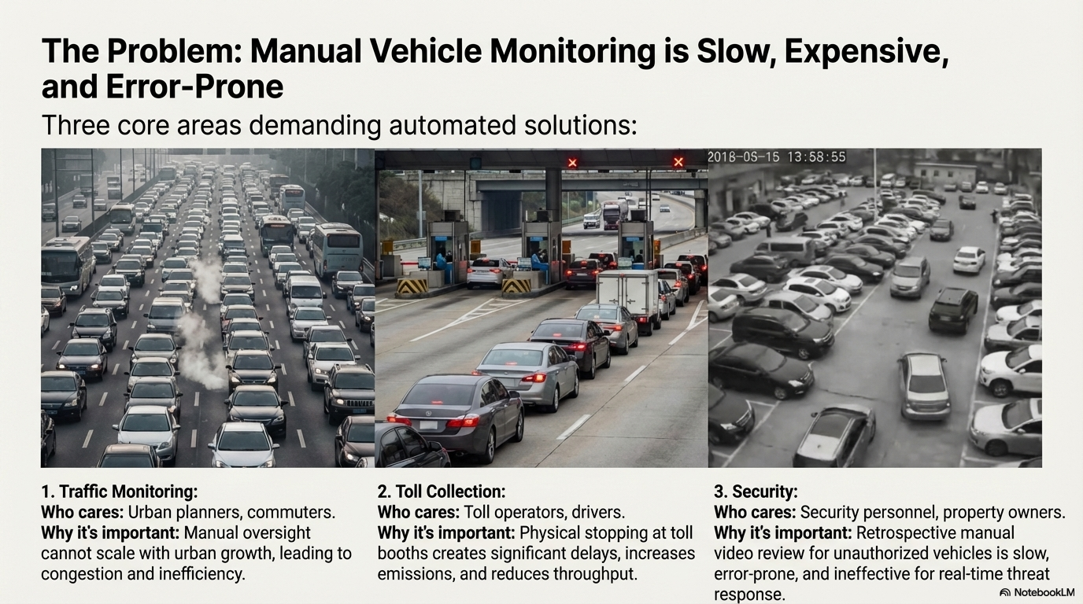
Notes:
Manual vehicle monitoring is slow, expensive, and error-prone. Think about three real-world areas: traffic monitoring, toll collection, and security. In each case, humans just can't keep up with the volume of vehicles — and the consequences of missing a plate can be significant. That's the gap this project addresses.

Slide 3
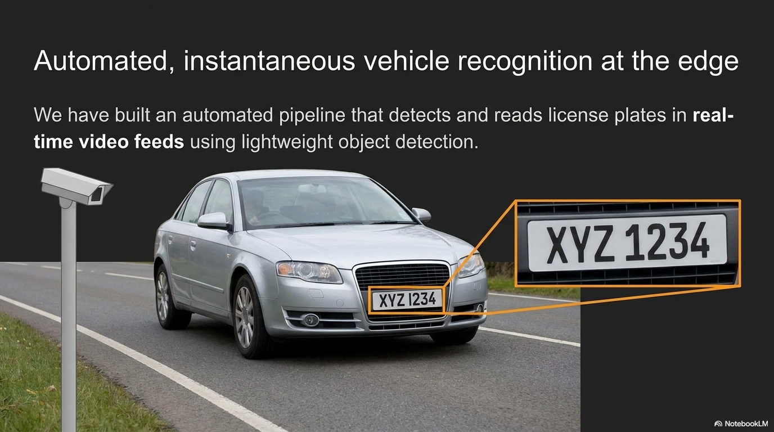
Notes:
The solution is a fully automated pipeline that detects and reads license plates in real-time from video. It uses lightweight object detection to find the plate, crops and cleans the image, and then OCR extracts the actual plate characters. The goal was to make this fast enough to run on edge hardware, not just a server.

Slide 4
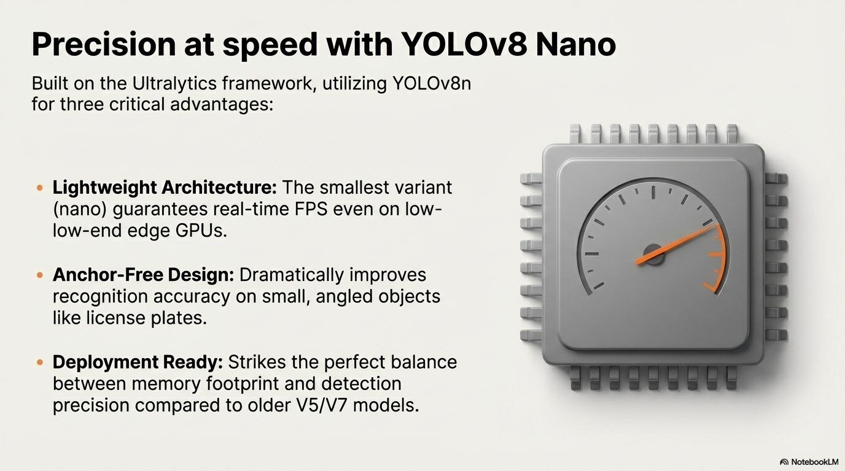
Notes:
I chose YOLOv8 Nano for three reasons. First, it's the smallest variant in the family — it can run at real-time frame rates even on low-end GPUs or edge devices. Second, it has anchor-free design, which makes it significantly better at detecting small, angled objects like license plates at a distance. Third, it hits the sweet spot between memory footprint and accuracy compared to older models like V5 or V7.

Slide 5
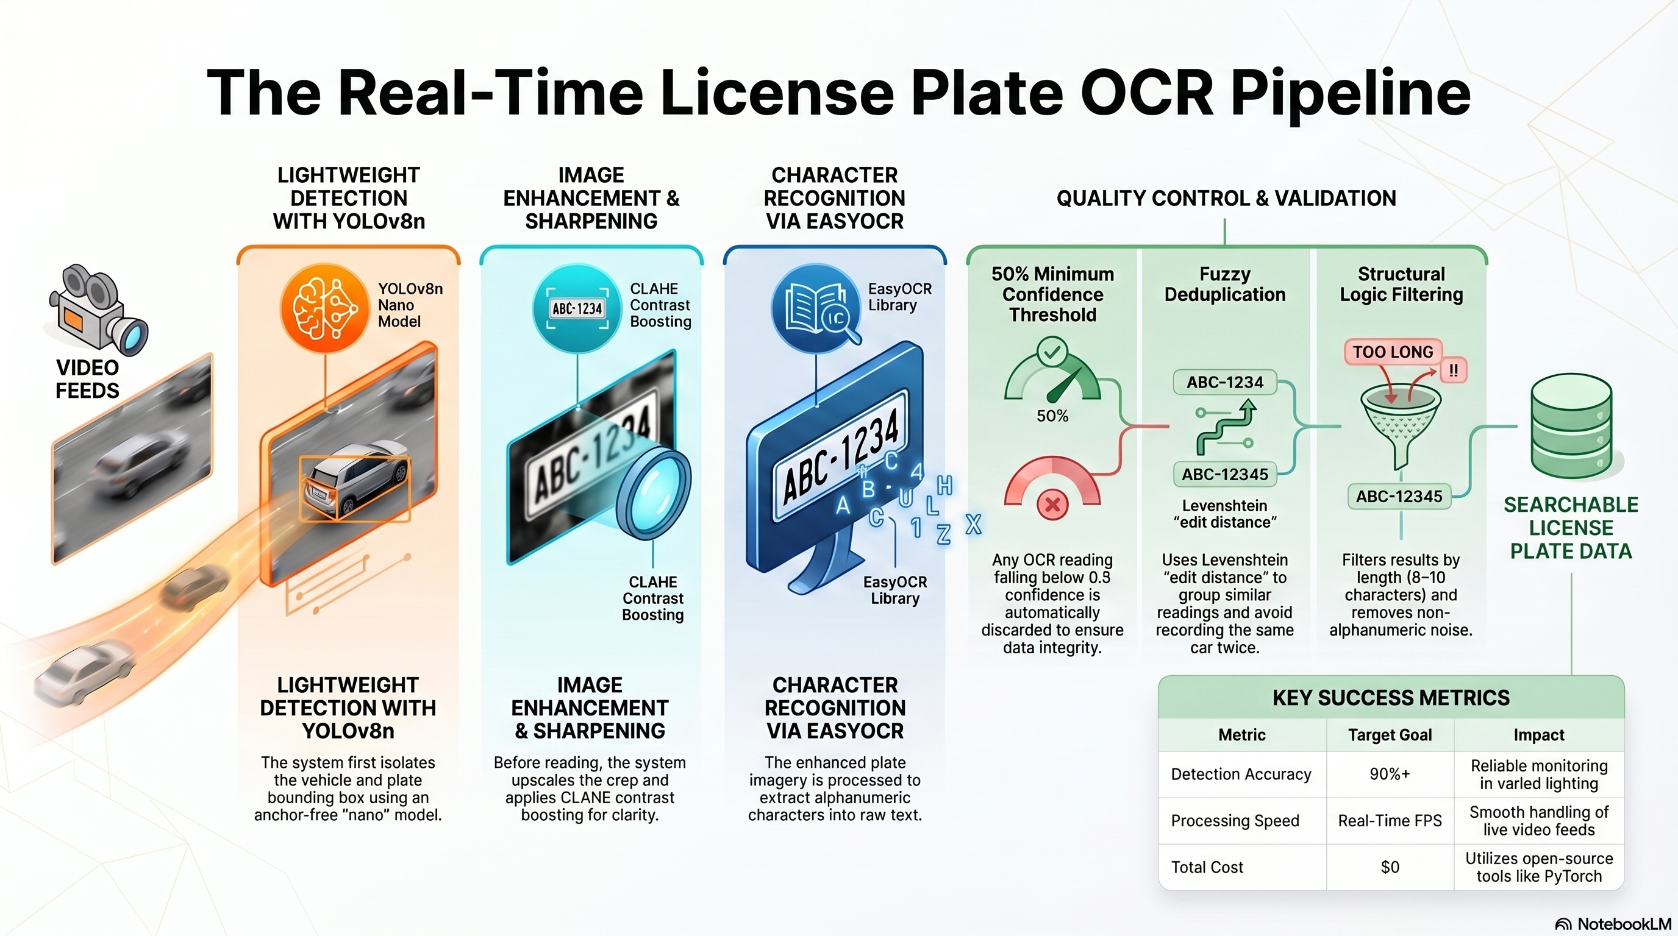
Notes:
The pipeline has four stages. Raw video frames come in, YOLOv8 detects and crops the plate region, then EasyOCR reads the characters. I added image enhancement between detection and OCR — sharpening and contrast adjustment — because raw crops from video are often blurry or poorly lit. Finally there's a quality control step that filters out short fragments and fuzzy duplicates.

Slide 6
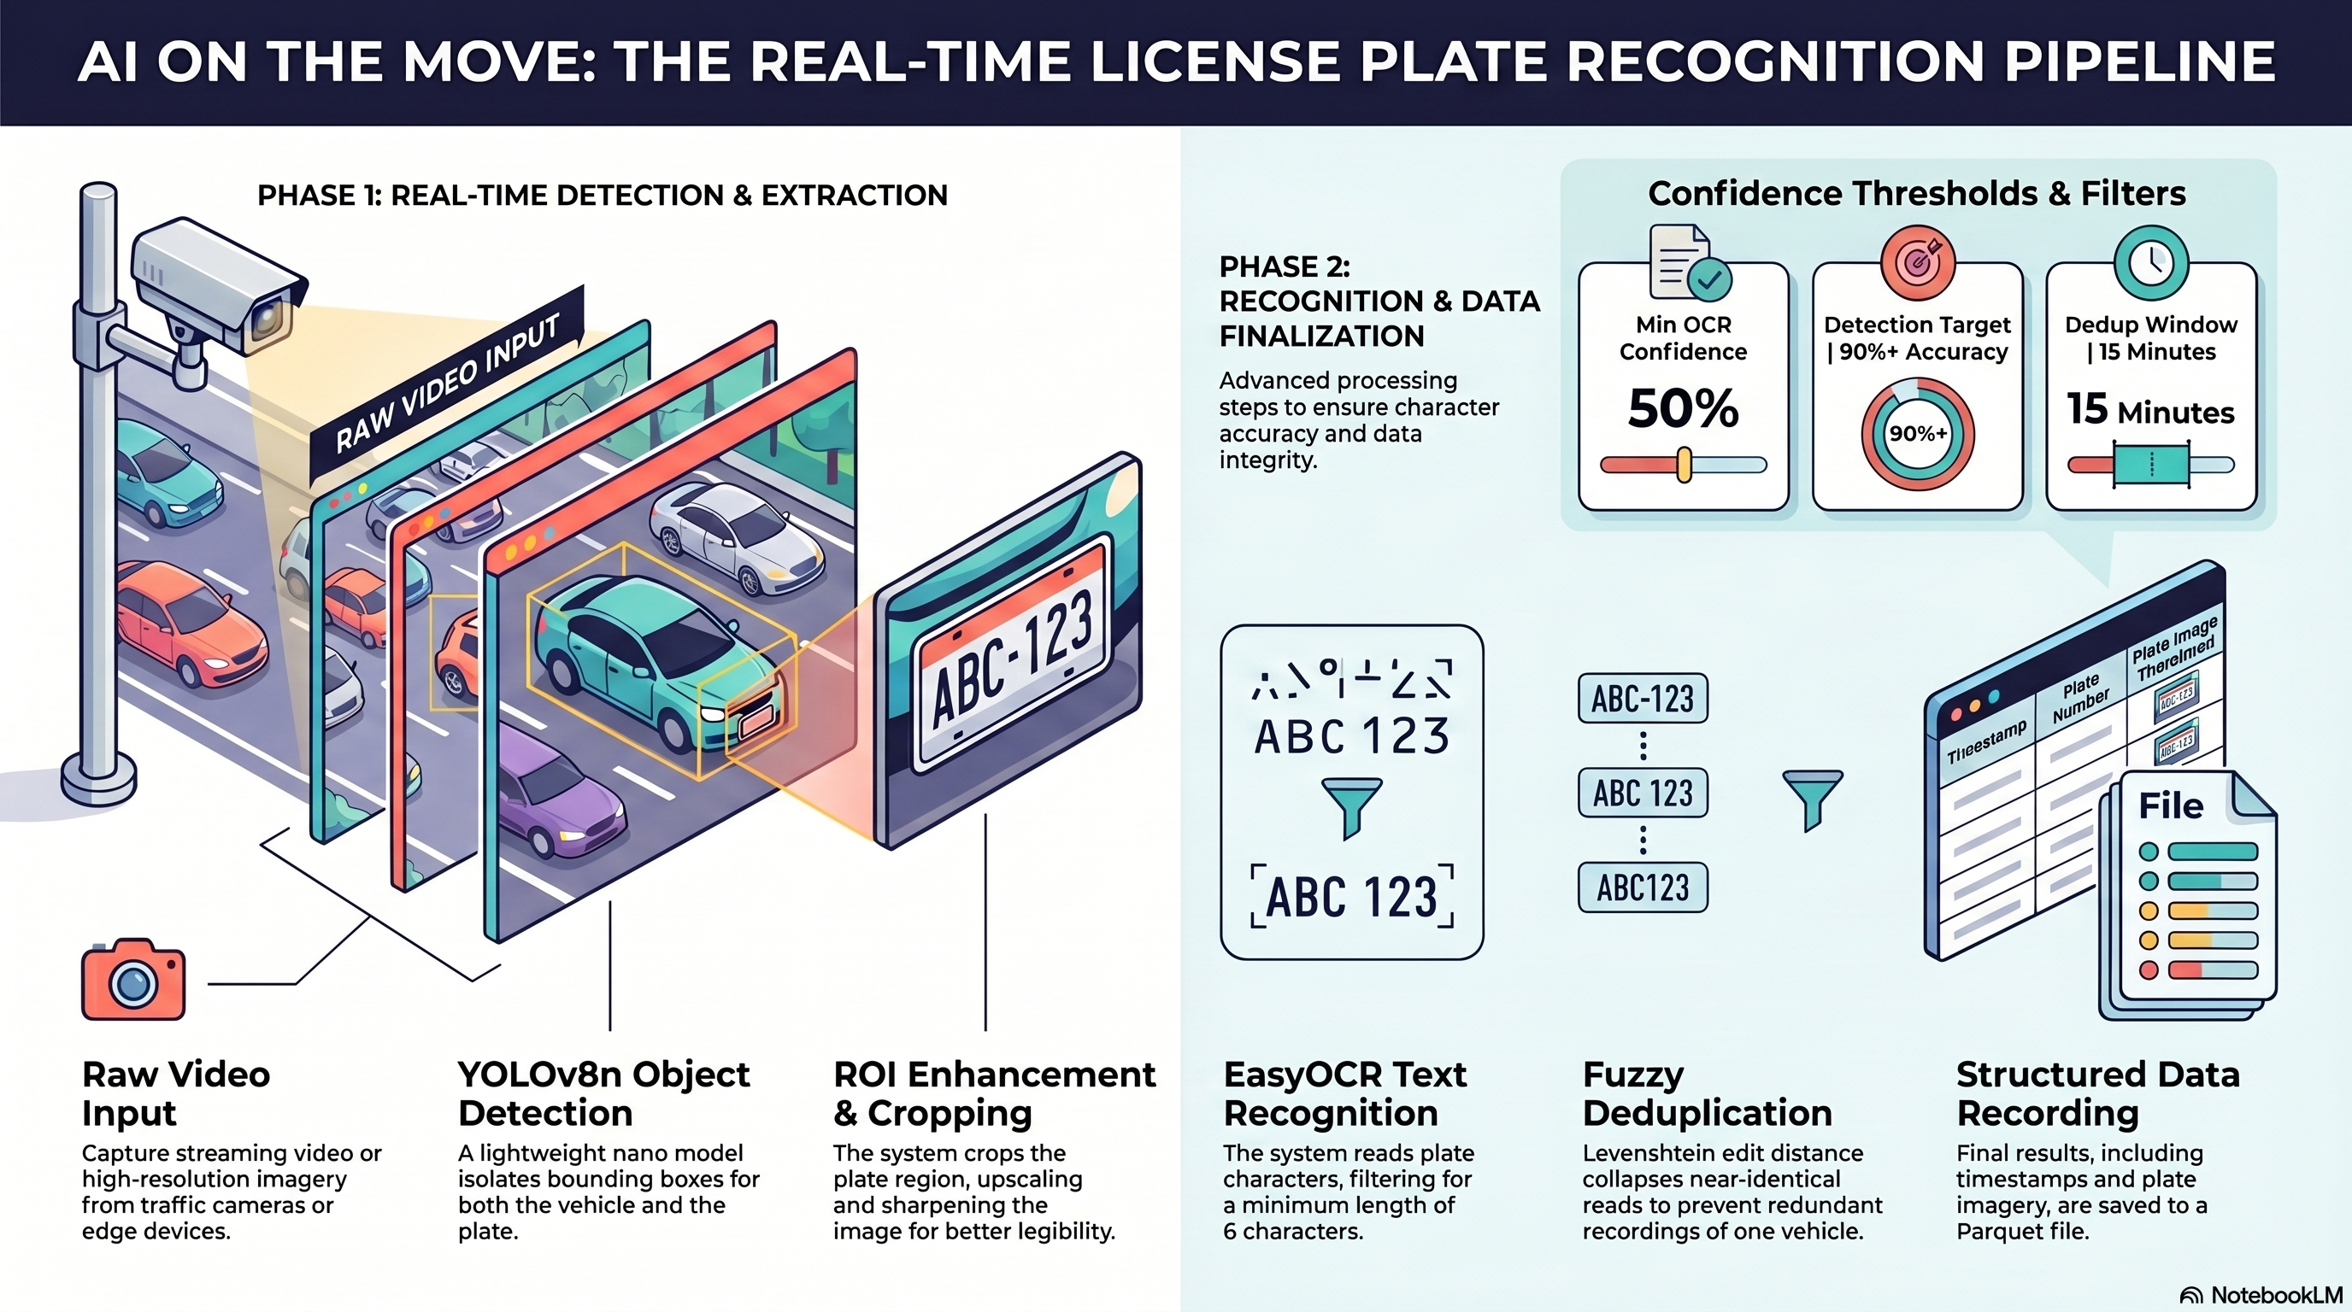
Notes:
Putting it all together: raw video goes into YOLO detection and extraction, then through ROI enhancement and cropping, then EasyOCR text recognition, then fuzzy deduplication, and finally structured storage as a Parquet file. The confidence threshold is set at 50%, and the deduplication window is 15 minutes — so the same plate won't be logged twice in a short period.

Slide 7
Live Demo
Notes:
Now I'll show the system running live on actual video footage. Watch how it detects the plate bounding box, crops it, and outputs the recognized text with a confidence score.

Slide 8
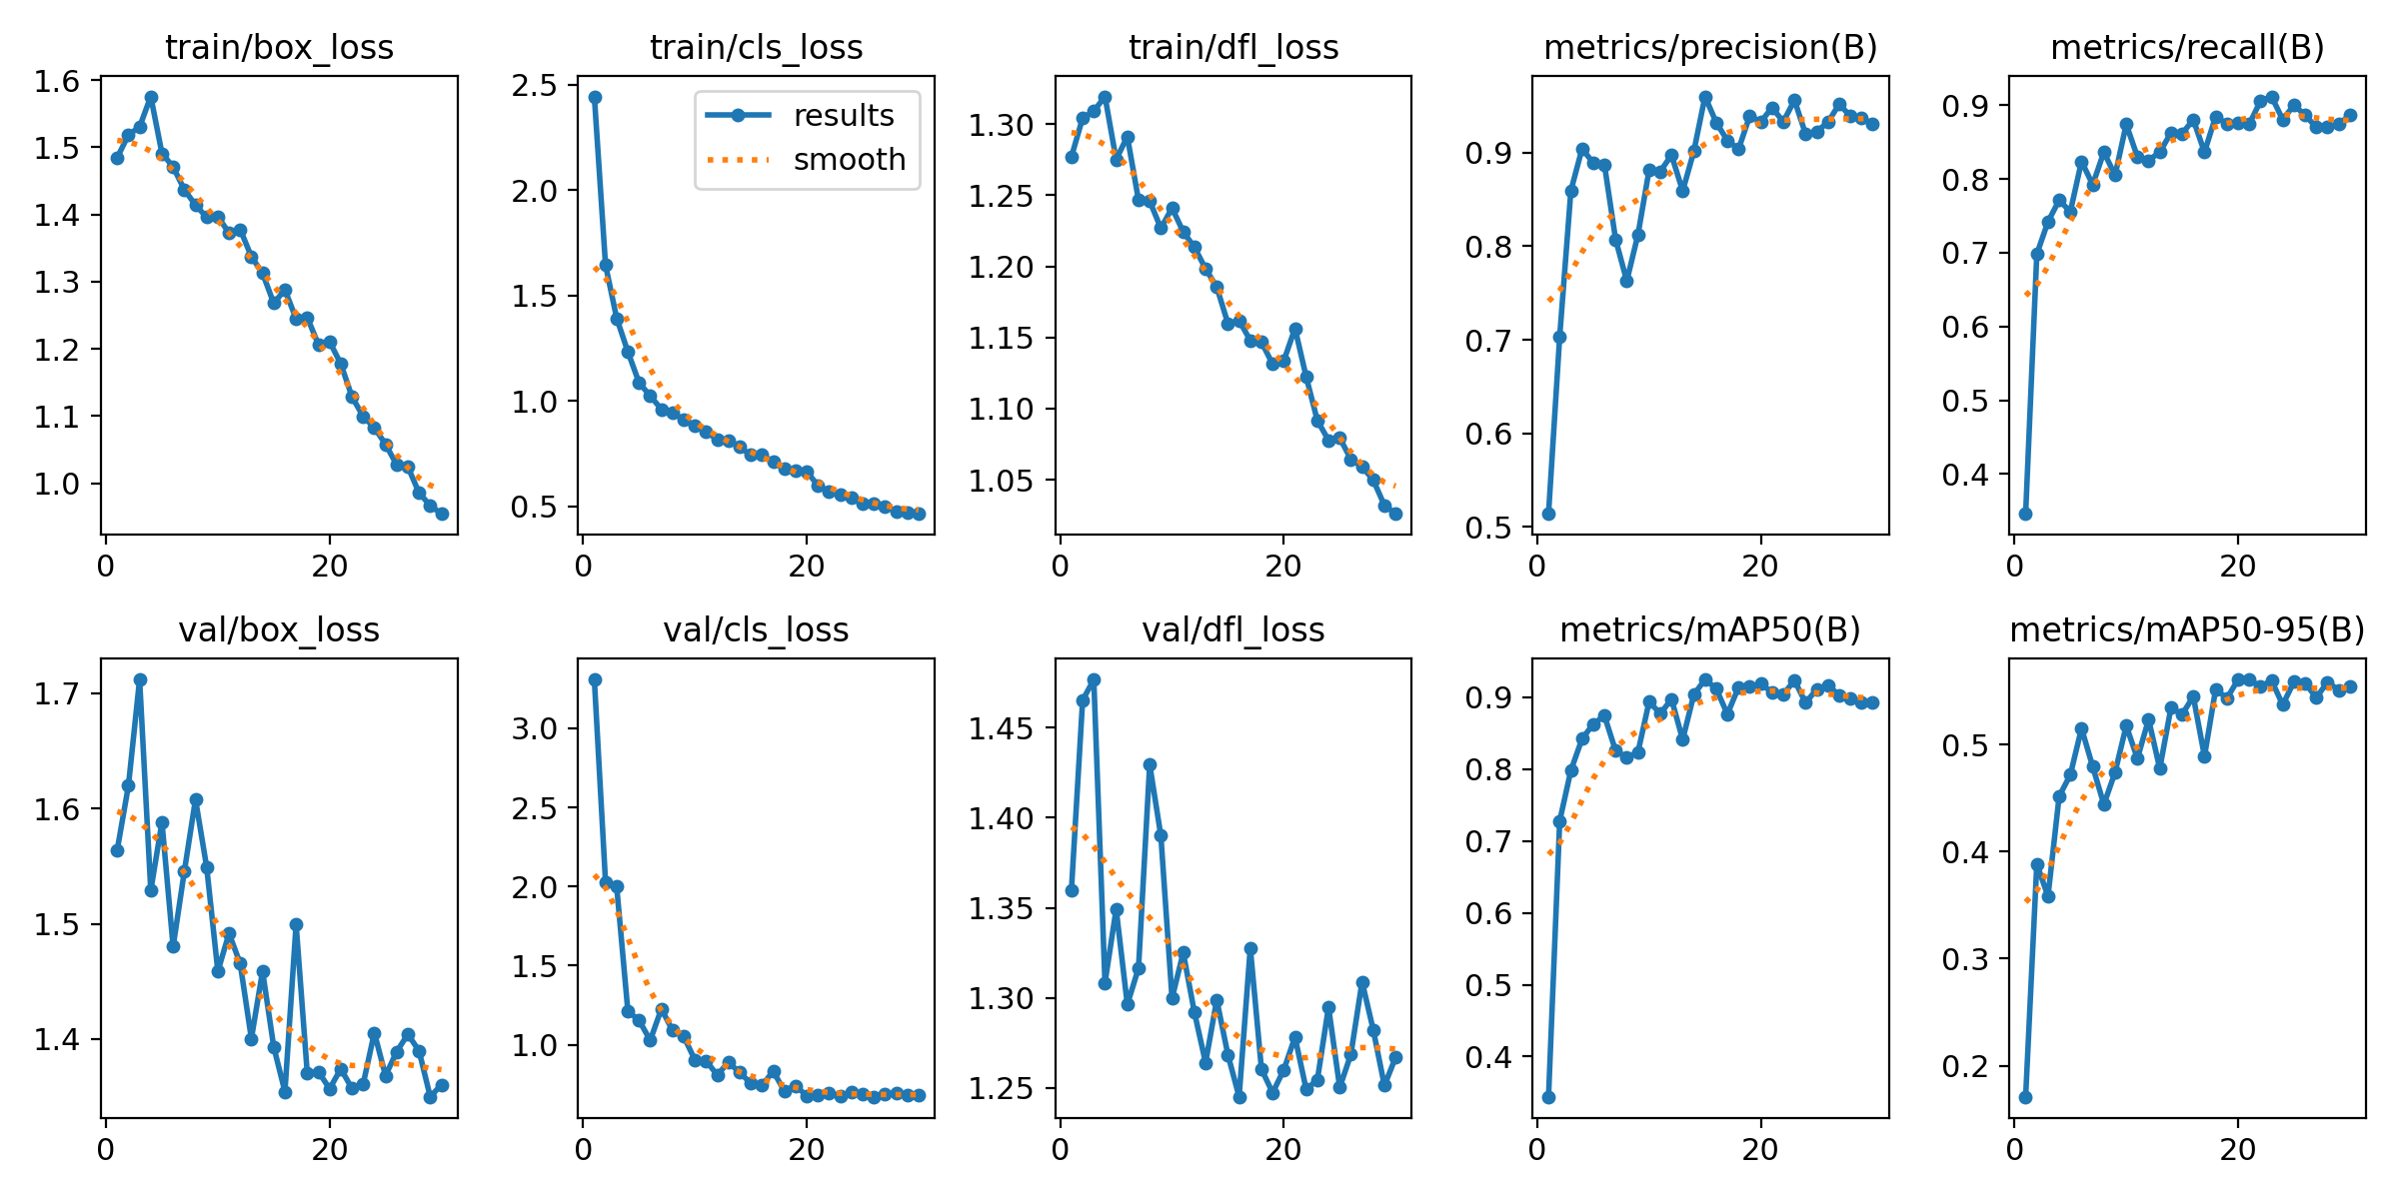
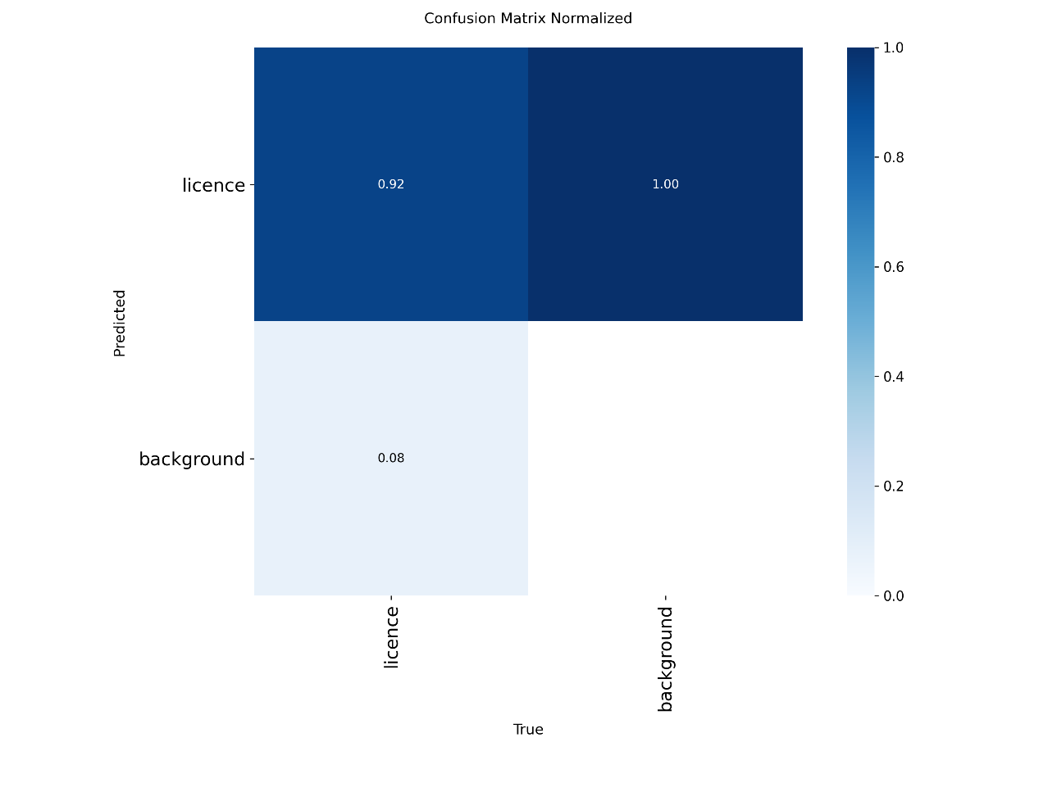
Performance Metrics
Precision and Recall
Precision ≈ 0.94
Recall ≈ 0.89
mAP Metrics
mAP50 ≈ 0.90
mAP50-95 ≈ 0.55
Notes:
Looking at the numbers: the model achieved a precision of 0.94 and recall of 0.89, which means it's finding almost all the plates and flagging very few false positives. The mAP at 50% IoU threshold came in at 0.90 — that's strong detection performance. The mAP50-95 of 0.55 is lower, which is expected — that metric is much stricter, averaging across tighter overlap thresholds.

Slide 9
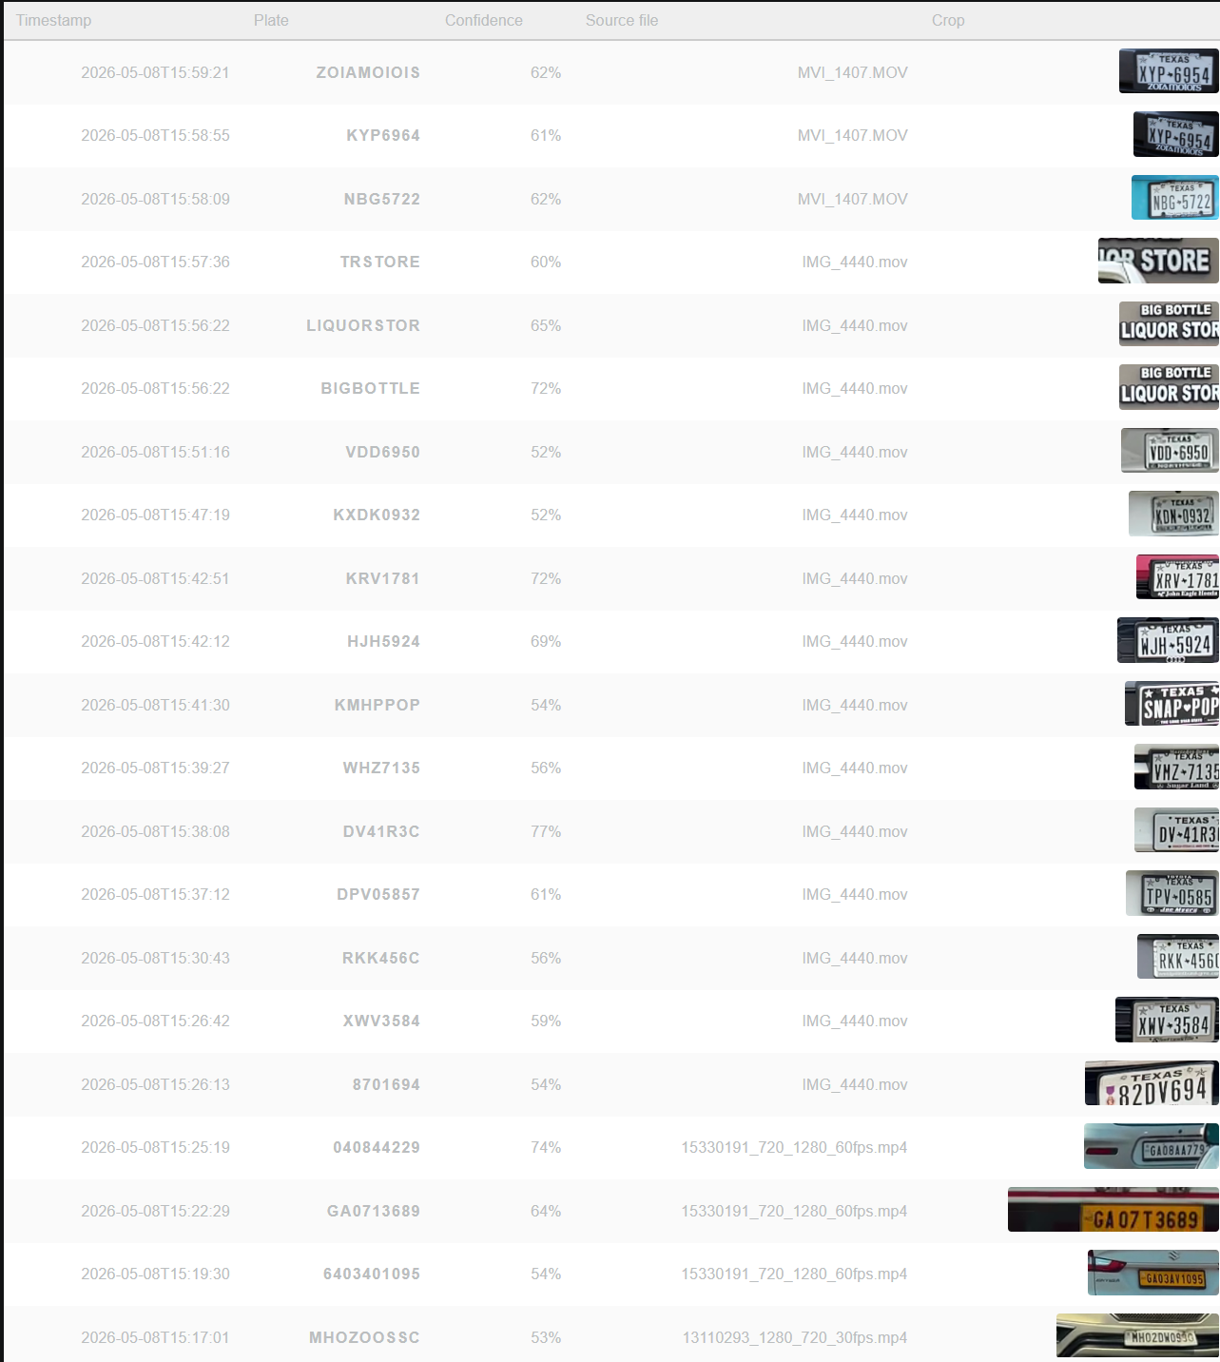
Actual Results
 | Total | Good | Bad
Identified License Plate | 21 | 18 | 3
Clear TX License Plate | 14 | 7 | 7
Selected Non-License Plate Data | 3 | 2 | 1
Foreign License Plate | 4 | 1 | 3
Notes:
When I ran it against real test videos, out of 21 total detections, 18 were good reads. The system handled standard plates well. Where it struggled was foreign plates and heavily stylized Texas plates — those had lower success rates, which makes sense given the training data was predominantly standard US formats. These failure cases actually point directly to how the model could be improved with more diverse training data.

Slide 10
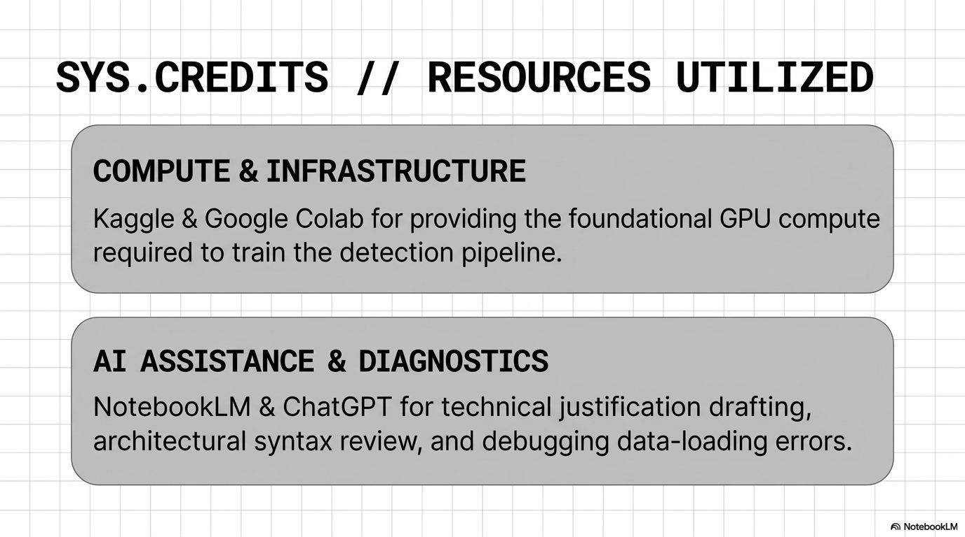
Notes:
I used Kaggle and Google Colab for GPU compute, NotebookLM and ChatGPT for technical drafting and debugging. The training data came from a Roboflow ANPR dataset under a Creative Commons license."

Slide 11
All documentation, files and code are available in GitHub.
https://github.com/rfox7/Rich_Fox_-_AI-Portfolio/tree/main/Computer%20Vision/Object_Detection_Project
Notes:
Now I'll show the system running live on actual video footage. Watch how it detects the plate bounding box, crops it, and outputs the recognized text with a confidence score.

Slide 12
Questions?
Notes:
Now I'll show the system running live on actual video footage. Watch how it detects the plate bounding box, crops it, and outputs the recognized text with a confidence score.

